Slide 1
Algorithms and Data Structures (CIS1002-N)
Week 2: Quick Recap on Sorting Algorithms
And Big-O Notation
Module Leader: Dr Annalisa Occhipinti
Email: A.Occhipinti@tees.ac.uk

Slide 2
Schedule
Week | Lecture (1hour) – Lab Session (2hours)
Week 1 | Introduction to Algorithms and their related Data-Structures – Array ADT
Week 2 | Sorting : Bubble sort, Cocktail Shaker sort
Week 3 | Sorting : Selection sort and Insertion sort
Week 4 | Singular Linked-lists
Week 5 | Doubly Linked-lists and Circular Linked-lists
Week 6 | Stacks
Week 7 | Queues
Week 8 | Recursion
Week 9 | Recursion
Week 10 | Recursion
Week 11 | Trees and balanced trees
Week 12 | Merge Sort and Quick Sort
Note: The schedule may be adjusted based on class progress.

Slide 3
Todays’ topics
Quick recap on sorting algorithms
Introduction to the concept of O-notation (Big-O Notation)
How to measure the efficiency of an algorithm
Blackboard test

Slide 4
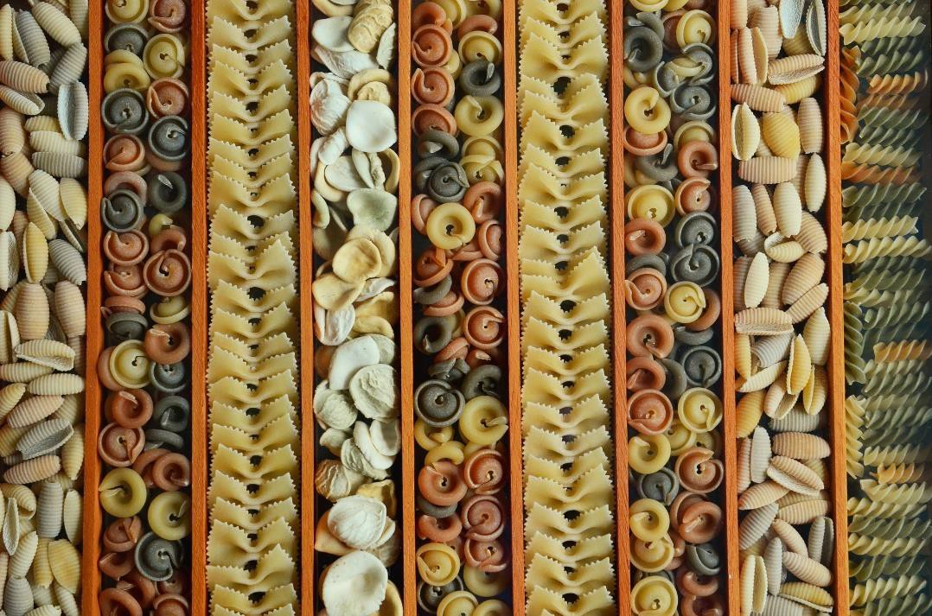
A quick reminder about Sorting Algorithms
Rote memorisation of the algorithms is not enough. If you just try to memorise them, you won’t score highly in this module.
Instead, we need to gain a deep understanding of the pros and cons of each of these algorithms, as well as how they can be implemented and optimised!

Slide 5
A quick recap on Bubble Sort
https://www.youtube.com/watch?v=nmhjrI-aW5o
Notes:
Java implementation Examples
https://www.flowerbrackets.com/bubble-sort-java/
https://www.tutorialspoint.com/data_structures_algorithms/bubble_sort_algorithm.htm
http://www.algolist.net/Algorithms/Sorting/Bubble_sort
Pseudo-code Examples: https://www.tutorialspoint.com/data_structures_algorithms/bubble_sort_algorithm.htm

Slide 6
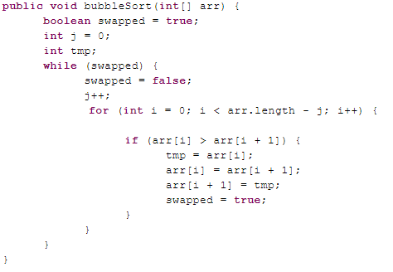
PROGRAM BubbleSort:
Integer Age[8] <- {44,23,42,33,16,54,34,18};
ReducingIndex <- N-2;
FOR j IN 0 TO N-1
DidSwap <- FALSE;
DO FOR Index IN 0 TO N-2-j
DO IF (Age[Index+1] < Age[Index])
THEN Temp_Value <- Age[Index+1];
Age[Index+1] <- Age[Index];
Age[Index] <- Temp_Value;
DidSwap <- TRUE;
ENDIF;
ENDFOR;
IF (DidSwap = FALSE)
THEN EXIT;
ENDIF;
ENDFOR;
END.
Why tmp?

Slide 7
Quick Question
Using the data provided in the following array [8, 3, 9, 6, 5],
Draw a step-by-step trace of the Bubble Sort algorithm.
Provide the pseudo-code for the Bubble Sort algorithm.
Write the time complexity formula for Bubble Sort (Big-O notation).
Provide the name of another sorting algorithm quicker than Bubble Sort.

Slide 8
Big-O notation (Part 1)
“Order of”

Slide 9
Introduction to O-notation
O-notation is a way to describe the time-effort of an algorithms. It indicates the worst-case run time for an algorithm.
In other words, how hard an algorithm may have to work to solve a problem.
For searching and sorting algorithms, this depends particularly on how many data elements there are.
Notes:
Two algorithms we have already seen in class.
So in the worst case, if you have n element in the array, it’ll take n units of time

Slide 10
Key Concepts
O-notation measures the efficiency of an algorithm (how many units of time the algorithm take to do run in the worst case scenario)
It measures how the number of time-units to run changes if the data-size increases.

Slide 11
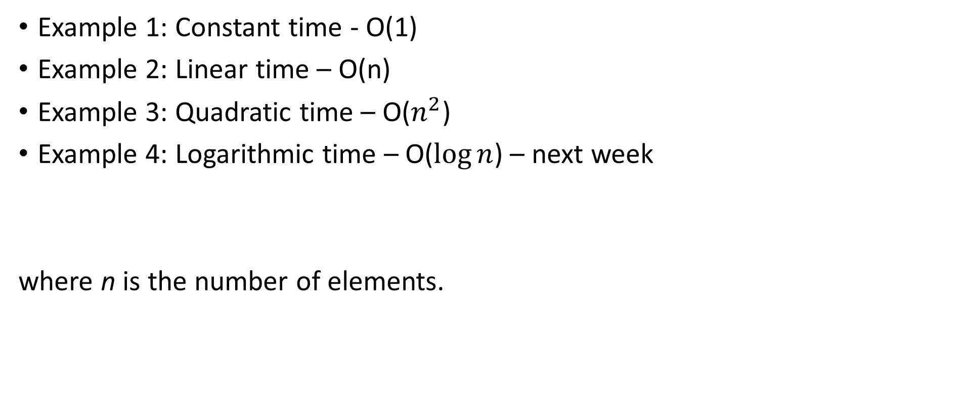
Let’s see how O-notation works…
Example 1: Constant time - O(1)
Example 2: Linear time – O(n)
Example 3: Quadratic time – O($n^{2}$)
Example 4: Logarithmic time – O($\log{n}$) – next week
where n is the number of elements.

Slide 12
Example 1 – Constant run-time – O(1)
Suppose an algorithm is designed to test whether the first element of an array is equal to the second.
If the array has 10 elements, this algorithm requires one comparison.
If the array has 1000 elements, it still requires one comparison.
In fact, the algorithm is completely independent of the number of elements in the array.
This algorithm is said to have a constant run time, which is represented in big O-notation as O(1).

Slide 13
Example 1 – Constant run-time – O(1)
An algorithm that is O(1) does not necessarily require only one comparison. O(1) just means that the number of comparisons is constant – it does not grow as the size of the array increases.
i.e. it takes the same time to perform the algorithm whatever the size of the array.
An algorithm that tests whether the first element of an array is equal to any of the next three elements is still O(1) even though it requires three comparisons.

Slide 14
Example 2 – Linear run time – O(n)
The Linear search algorithm searches each element in an array sequentially. If the search key does not match an element in the array, the algorithm tests each element until all are tested.
If the search key is in the array, the algorithm tests each element until it finds one that matches the search key and returns the index of that element.
Big-O notations is interested in the worst case scenario!
Notes:
Two algorithms we have already seen in class.
So in the worst case, if you have n element in the array, it’ll take n units of time

Slide 15
Example 2 – Linear run time – O(n)
The algorithm tests whether the first array element is equal to any of the other array elements will require at most n-1 comparisons, where n is the numbers of array elements.
If the array has 10 elements, this algorithm requires up to nine comparisons.
If the array has 1000 elements, it requires up to 999 comparisons.

Slide 16
Example 2 – Linear run time – O(n)
As n grows larger, the n part of the expression n - 1 “dominates”, and subtracting one becomes inconsequential. Big O is designed to highlight these dominant terms and ignore terms that become unimportant as n grows.
For this reason, an algorithm that requires a total of n-1 comparisons (such as the one just described) is said to be O(n), and pronounced “order n” or “Oh of n”.
An O(n) algorithm is referred to as having a linear run time.

Slide 17
Example 3 – Quadratic run time – O(n²)
Now suppose you have an algorithm that tests whether any element of an array is duplicated elsewhere in the array.
The first element must be compared with every other element in the array.
The second element must be compared with every other element except the first (it was already compared to the first).
The third element must be compared with every other element except the first two.

Slide 18
Example 3 – Quadratic run time – O(n²)
In the end, this algorithm will end up making :
(n-1) + (n-2) + … + 2 + 1 or (n – 1)*n/2 comparisons.
As n increases, the n² term dominates and the n term becomes inconsequential.
Big O-notation highlights the n² term, leaving n²/2.
But constant factors are omitted in big O notation as we are only interested in the general order of growth.
Notes:
Plot n² against n on the board

Slide 19
Example 3 – Quadratic run time – O(n²)
An O(n²) algorithm running on a million-element array would require a trillion operations which could take several hours.
A billion-element array would require a quintillion operations, a number so large that the algorithm would take decades!
Unfortunately, O(n²) algorithms are easy to write.
There are more efficient algorithms, but these require a bit more cleverness and work to create.

Slide 20
Example 3 – Quadratic run time – O(n²)
However their superior performance can be well worth the extra effort, especially as n gets large and as algorithms are combined into larger programs.
The linear search algorithm is O(n) time.
The worst case in this algorithm is that every element must be checked to determine whether the search item exists in the array.
If the size of the array is doubled, the number of comparisons that the algorithm must perform is also doubled.
Note that it can provide outstanding performance if the element matching the search key happen to be at or near the front of the array.

Slide 21
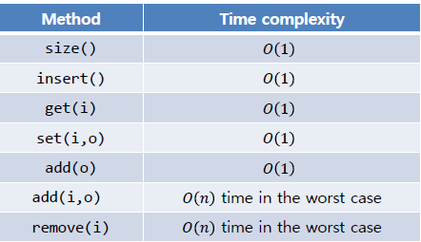
Big O notation and Dynamic Arrays
Describes an upper bound for the running time T(n) of an algorithm (worst case running time)
The O symbol was introduced in 1927 to indicate relative growth of two functions…
The running time of an algorithm typically grows with the input size.
Time Complexity:

Slide 22
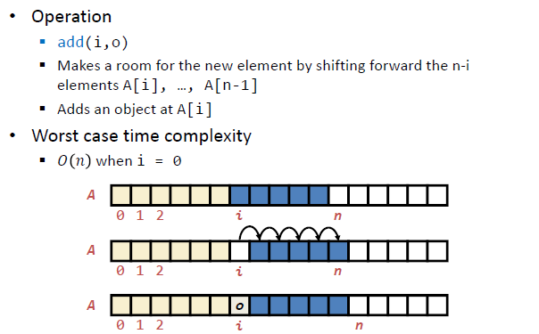
Time Complexity: Insertion

Slide 23
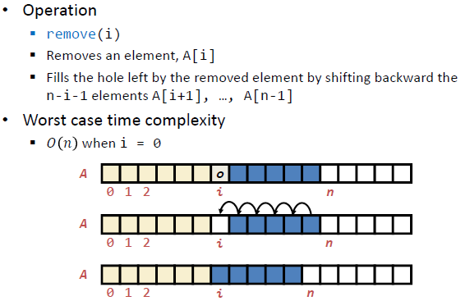
Time Complexity: Removing

Slide 24
Write the Java code for… Bubble Sort
Exam Question
Basic definition:
Starting from the left
Compare two neighbouring items,
If the one on the left is greater, swap them
Move right by one, go to step 1
Can you optimise it?
Share your solution in the chat

Slide 25
Exercise - 1
Write the Java code for the method to find the minimum value of the array below:
a = {5, 6, 4, 1, 3} a.length = 5
Public void findMin(int[] a){
}

Slide 26
Exercise - 2
Now, Write the Java code to find the minimum value of the sub-array {4,1,3},
which is the array made of the items at index 2, 3 and 4 in a.
Public void findMinSubarray(int[] a, int start, int end){
}

Slide 27
Exercise - 3
How would you change the method findMinSubarray to return the index of the minimum value?

Slide 28

BlackBoard Test
This is not part of the ICA, it’s just a quiz to test your knowledge so far.

Slide 29
Questions?

